Slide 1
1/9/19 Meeting Update
Welcome back

Slide 2
Agenda
Progress
Competition entry
Gantt chart update
Action items

Slide 3
Progress

Slide 4
Communications
TI CC2652 Multiprotocol Wireless MCU (same as Axxon Mobile)
Embedded ARM Cortex M4F processor
TX/RX BLE
Programmable output power
Datasheet power consumption
RX: 6.83 mA
TX: 7.5 mA
Shutdown: 125 nA
Ordered & arrived on Monday
Prototype implications:
PCB considerations - need external antenna
Code - will work with Benjamin & Aidan to get the code updated

Slide 5
Prototype #1 Fuel Gauge Problem
Code
Found additional parameters that we missed (terminate voltage, taper rate, etc.)
Axxon Mobile is using this as well
Physical system configuration
Needs to be in series with the energy harvester and load for the Coulomb counter to work (we think)
Experiments will be performed today and through the remainder of the week to finalize Fuel Gauge architecture/code

Slide 6
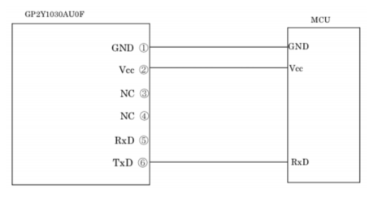
Particulate sensor
Unit test code in-progress
Example code + I2C code from current project
Issue: incorrect start condition flag (expect: 0xFF, 0xFA, receiving 0xFF, 0xFF)
Potential culprits: baud rate setting, interrupts not being set… bit bashing ahead
Once that is done, integrate with the rest of the system
PCB considerations:
Figure out how to plug it into the rest of the system
Vcc (ref sheet: 5V), GND, Tx (sensor doesn’t need Rx)

Slide 7
PCB
Primary components added to shared Eagle library
MSP430
Bluetooth chip
Temperature sensor
Fuel gauge
Energy harvester
Buck boost converter(s)
Found MacroFab’s DRC files, Eagle libraries, CAM files, etc.

Slide 8
Competitions
Collegiate Inventors Challenge
Essay/abstract of design, letter of recommendation from faculty, a literature and patent search summary, any supporting materials (graphs, videos, etc.)
Submission in Spring 2019
Final round of judging in Virginia in November
Max of 4 people in a team - is that an issue?
James Dyson Award Competition
Essay/abstract of design, images (prototype sketches, finished product, etc.), optional video
Entry period Mar. 27 - Jul. 21
No award ceremony
Max 10 people in a team
Rice Undergraduate Research Symposium

Slide 9
Logistics
Updated team contract
Re-negotiated meeting times

Slide 10
Gantt Chart

Slide 11
Action Items - by Fri 1/11
Choose & sign up for a competition (add deadline to Gantt chart)
Identify PCB requirements for
Bluetooth chip & antenna
Particulate sensor
Code
Particulate sensor unit test code
Fix fuel gauge problem
Start PCB design

Slide 12
Action Items - by Fri 1/18
Understand power system PCB requirements
Complete PCB design
By Wed 1/23
Finished design review
PCB order placed

Slide 13
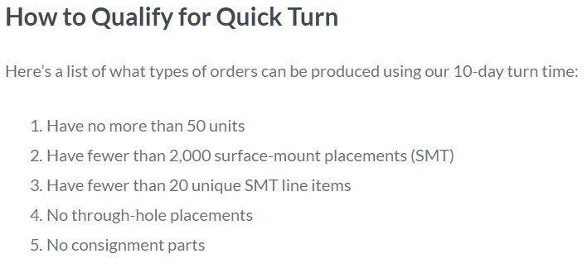
PCB Design
Since MacroFab orders the parts, does that mean we shouldn’t?
Resources for learning good PCB design?
Trace widths
Spacing
Everything

